Slide 1


Green Pace
Security Policy Presentation
Developer: Elise Smith

Slide 2

OVERVIEW: DEFENSE IN DEPTH
The Green Pace Security Policy was established to standardize and strengthen our approach to secure software development as the team
grows and faces evolving cyber threats. This policy ensures that all developers adhere to consistent security practices, addressing vulnerabilities
in coding and systems architecture while aligning with industry best practices. By integrating a defense-in-depth strategy, which applies multiple
layers of protection—from coding standards to encryption and automated security checks—the policy mitigates risks, ensuring our systems and
data remain secure even if one layer is compromised. Ultimately, this policy helps Green Pace maintain security excellence throughout the
development lifecycle.

Slide 3
THREATS MATRIX
Likely STD-005-CPP: Memory leaks or improper deallocation can lead to security exploits or crashes, especially if attackers manipulate system resources. STD-004-CPP: Issues in pointer management can lead to vulnerabilities, such as SQL injections if data is improperly handled. | Priority STD-001-CPP: Buffer overflows are a critical threat that can lead to unauthorized code execution or crashes, which makes them high priority for mitigation. STD-002-CPP: If developers use invalid iterators or pointers, it leads to undefined behavior, potentially introducing critical security issues.
Low priority STD-008-CPP: Not properly closing files after use can lead to security vulnerabilities but is generally a lower-priority issue compared to buffer overflows or injection attacks STD-009-CPP: This is less common but can cause undefined behavior when deleting derived class objects through base class pointers | Unlikely STD-003-CPP: While unlikely, not checking for null pointers can lead to undefined behavior. It’s a risk that can generally be caught early in testing. STD-007-CPP: Failure to catch exceptions early in the program is an unlikely threat but can cause major issues if not handled properly.
Likely: These are high probability risks that need immediate attention.
Priority: These are critical risks that should be prioritized due to the potential severity of impact.
Low priority: These risks have a lower likelihood but should still be monitored.
Unlikely: These risks are considered rare but need to be documented.

Slide 4
10 PRINCIPLES
Validate Input Data
Associated Coding Standard
[STD-003-CPP]: Do not attempt to create a std::string from a null pointer
Heed Compiler Warnings
Associated Coding Standard
[STD-001-CPP]: Do not cast to an out-of-range enumeration value
[STD-006-CPP]: Use a static assertion to test the value of a constant expression
Architect and Design for Security Policies
Associated Coding Standard
[STD-007-CPP]: Handle all exceptions thrown before main() begins executing
Keep It Simple
Associated Coding Standard
[STD-002-CPP]: Use valid references, pointers, and iterators
[STD-010-CPP]: Do not return from a function declared [[noreturn]]
Default Deny
Associated Coding Standard
[STD-009-CPP]: Do not delete a polymorphic object without a virtual destructor
Adhere to the Principle of Least Privilege
Associated Coding Standard
[STD-004-CPP]: Do not store an already-owned pointer value in an unrelated smart pointer
[STD-005-CPP]: Properly deallocate dynamically allocated resources
Sanitize Data Sent to Other Systems
Associated Coding Standard
[STD-003-CPP]: Do not attempt to create a std::string from a null pointer
Practice Defense in Depth
Associated Coding Standard
[STD-007-CPP]: Handle all exceptions thrown before main() begins executing
[STD-008-CPP]: Close files when they are no longer needed
Use Effective Quality Assurance Techniques
Associated Coding Standard
[STD-002-CPP]: Use valid references, pointers, and iterators
Adopt a Secure Coding Standard
Associated Coding Standard
[All standards] – The complete policy follows this principle by following industry-recognized secure coding practices.

Slide 5
CODING STANDARDS
1. [STD-005-CPP]: Properly deallocate dynamically allocated resources
Priority: High — Memory management issues such as memory leaks and double-free vulnerabilities are critical and can lead to severe security risks if exploited.
2. [STD-001-CPP]: Do not cast to an out-of-range enumeration value
Priority: High — Buffer overflows and type casting errors can lead to serious vulnerabilities, such as arbitrary code execution, making this a top priority.
3. [STD-004-CPP]: Do not store an already-owned pointer value in an unrelated smart pointer
Priority: High — Mismanagement of pointers can cause double-free errors, leading to program crashes or exploitable vulnerabilities.
4. [STD-002-CPP]: Use valid references, pointers, and iterators
Priority: High — Invalid or dangling pointers and iterators are a frequent source of undefined behavior, which can lead to unpredictable security risks.
5. [STD-003-CPP]: Do not attempt to create a std::string from a null pointer
Priority: Medium — Null pointer dereferencing can lead to crashes and undefined behavior but is less likely than pointer management errors.
6. [STD-009-CPP]: Do not delete a polymorphic object without a virtual destructor
Priority: Medium — This issue can result in undefined behavior and potential memory leaks, which, while less common, still pose significant risks.
7. [STD-007-CPP]: Handle all exceptions thrown before main() begins executing
Priority: Medium — Proper exception handling prevents crashes during initialization, which can compromise system stability and security.
8. [STD-006-CPP]: Use a static assertion to test the value of a constant expression
Priority: Medium — Static assertions are useful for catching potential errors at compile time, reducing the risk of runtime issues.
9. [STD-008-CPP]: Close files when they are no longer needed
Priority: Low — While resource management is important, failing to close files is less severe compared to memory management or buffer overflow vulnerabilities.
10. **[STD-010-CPP]**: Do not return from a function declared `[[noreturn]]`
**Priority**: Low — Returning from a function marked as `[[noreturn]]` is rare but can lead to undefined behavior if not handled properly.
---

Slide 6
ENCRYPTION POLICIES
Rest - Data encryption at rest protects stored data from unauthorized access by converting it into an unreadable format, like AES. This policy requires that all sensitive data, including databases and backups, be encrypted in storage. It also emphasizes secure management of encryption keys and limits access through role-based controls (RBAC). Regular monitoring is essential to ensure compliance and detect unauthorized access. Encrypting data at rest safeguards against breaches and maintains confidentiality.
Flight –Encryption in transit protects data while it's being sent between systems, such as over the internet or internal networks. This policy requires that all sensitive data exchanged between users, servers, or devices be encrypted using protocols like TLS or IPSec. Organizations must ensure that web traffic, email, APIs, and other communication channels are secure. This prevents unauthorized access, keeps data private, and complies with regulations like GDPR and HIPAA.
Use - When data is processed by applications, encryption is crucial for security, protecting it from potential attackers. Techniques like homomorphic encryption and trusted execution environments (TEEs) should be used for sensitive operations such as financial transactions and personal data handling. Encrypting data in use prevents unauthorized access, reducing the risk of data breaches and ensuring confidentiality during processing, especially in high-risk environments.

Slide 7
TRIPLE-A POLICIES
Authentication – Authenticating ensures that a user, system, or device is who they claim to be. To secure access, systems should utilize strong authentication methods, such as combining a password with a fingerprint or special code. Users must use at least two methods for access to important systems or data. Keeping these methods updated prevents vulnerabilities. Strong authentication protects against unauthorized access, including hackers, and helps organizations meet security regulations.
Authorization – Authorization determines what actions or resources a user can access, ensuring they only access data necessary for their roles. This is typically managed through role-based access control (RBAC). Regularly reviewing and updating access rights based on job responsibilities helps prevent unauthorized access and reduces the risk of data leaks. Effective authorization protects system resources for those with the appropriate permissions.
Accounting - Accounting involves recording user activities on a system to ensure security and compliance. All access to systems, data, and key actions must be logged, detailing who did what and when. These records should be secured and regularly reviewed for suspicious activity. This practice promotes accountability, aids in investigations, and is vital for transparency and quick detection of security issues.

Slide 8
Unit Testing
I chose to test the memory leaks and proper deallocation vulnerability. The tests ensure that the collection is properly cleared and deallocated in methods like collectionclearscorrectly, collectionresetscorrectly, doublecleardoesnotcauseissues and collectionresetafterclear. These tests help catch memory leaks by ensuring resources are properly freed after use.

Slide 9
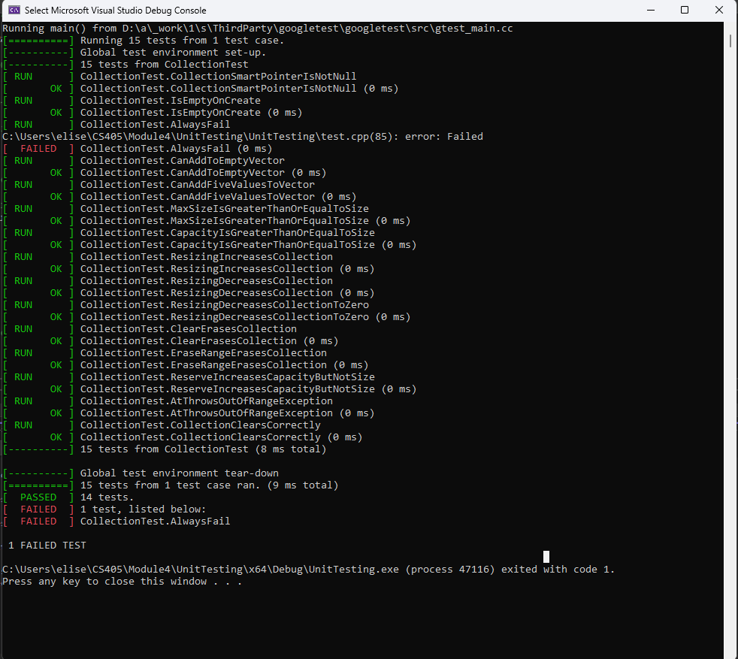
Collection Clears Correctly (Positive Test)
This test ensures that clearing the collection frees up memory and reduces the side of the collection to 0.

Slide 10
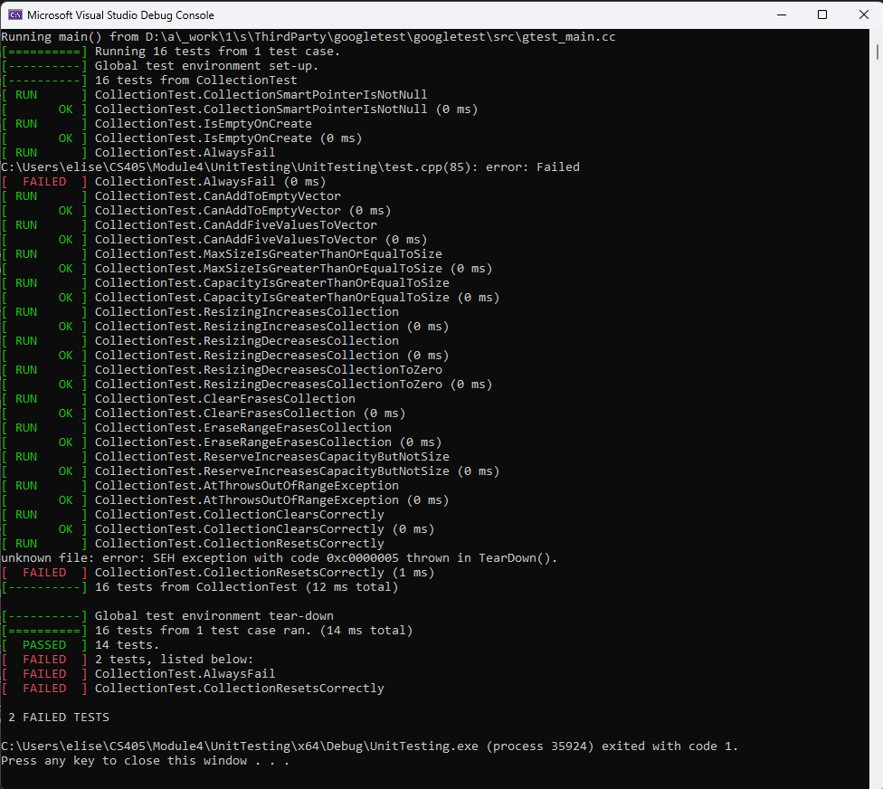
Collection Resets Correctly (Positive Test)
Verifies that resetting or deleting the collection frees memory and sets the pointer to null.

Slide 11
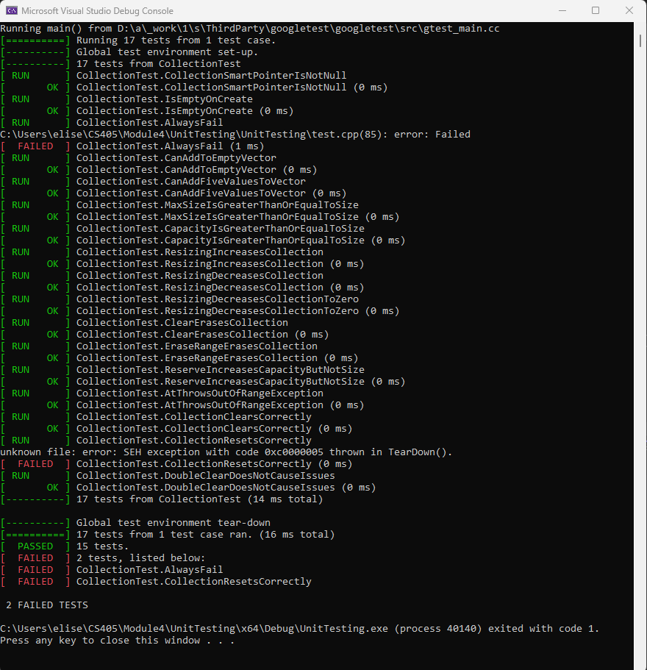
Double Clear Does Not Cause Issues (Negative Test)
Ensures that calling clear() multiple times on the same collection does not cause any memory related issues.

Slide 12
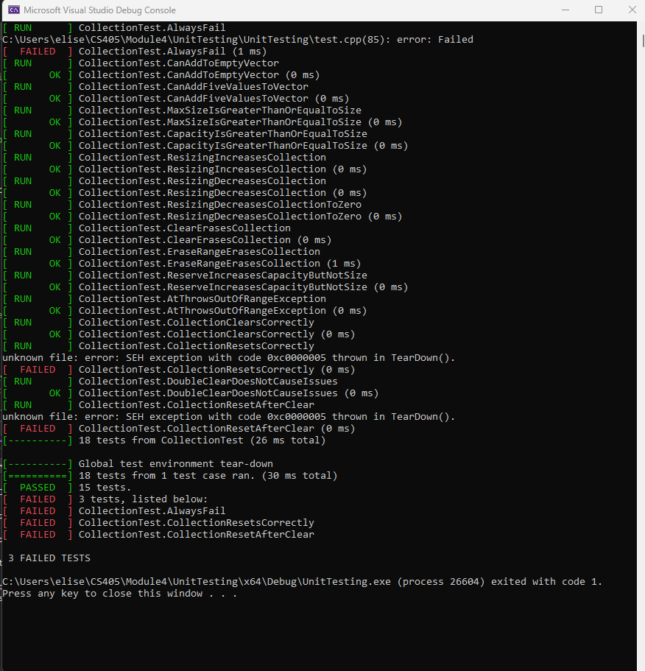
Collection Reset After Clear (Negative Test)
Ensure that clearing a collection and then resetting it does not cause memory leaks or crashes.

Slide 13

AUTOMATION SUMMARY

Slide 14
TOOLS
The DevSecOps pipeline makes security a priority at every stage of software development. This ensures that security practices are integrated from the design phase all the way to production. In the pre-production phase, teams incorporate security while designing, building, and testing the software. Developers follow secure coding practices and use tools like Cppcheck for static analysis during building, verifying, and testing. This helps them find problems like buffer overflows, memory leaks, and unsafe operations early, keeping these issues from reaching production.In the production phase, monitoring and real-time detection of security threats become crucial. After deployment, the system is monitored continuously for any security incidents. Logging and alerting systems help identify potential threats quickly. If a security issue arises, automated processes can quickly respond, blocking attacks or rolling back services to keep the system stable. This ongoing feedback loop helps Green Pace maintain a secure development environment without slowing down the process.

Slide 15
RISKS AND BENEFITS
Delaying action on security vulnerabilities increases the risk of exploits. If issues like memory leaks, buffer overflows, or improper access controls aren't addressed quickly, attackers may exploit these weaknesses, resulting in data breaches or service disruptions. Acting promptly helps identify and mitigate vulnerabilities, reducing the risk of costly attacks. However, immediate action can slow down development timelines. If we wait, we become reactive, leading to higher long-term costs and potential damage to our reputation. Furthermore, our current security strategy may lack continuous testing and full automation across development stages. To mitigate these risks, we should prioritize implementing security automation tools, such as static analysis and continuous vulnerability scanning. Regular testing and automated responses will ensure security is an ongoing priority rather than an afterthought.

Slide 16
RECOMMENDATIONS
One major issue in the current security policy is the lack of focus on ongoing real-time monitoring and response. While the policy addresses vulnerabilities during development and before production, it does not prioritize monitoring for new threats once the software is live. This creates a potential blind spot after deployment. Additionally, the policy offers limited guidance on regular penetration testing and manual code reviews. These practices are vital for finding sophisticated vulnerabilities that automated tools might overlook. The policy also misses a strategy for resilience testing, such as using chaos engineering to simulate unexpected failures or attacks. Addressing these gaps is essential for building a stronger and more proactive security approach.

Slide 17
CONCLUSIONS
To improve security and avoid future problems, organizations should adopt recognized standards like OWASP's Secure Coding Practices and the Common Weakness Enumeration (CWE) guidelines. These standards help reduce common vulnerabilities, such as injection flaws, poor error handling, and insecure deserialization, which are essential for modern software. After deployment, following NIST’s Cybersecurity Framework can help with continuous monitoring and incident response to keep security strong. Additionally, standards like ISO/IEC 27001, which focus on information security management, provide a clear method for security practices, governance, and risk management. This helps ensure that the whole organization follows a consistent and secure approach at every level of development and deployment.

Slide 18
REFERENCES
Martinez, J. (2024, September 27). What is AAA Security? Authentication, Authorization, and Accounting. Identity and Access Management. https://www.strongdm.com/blog/aaa-security
Martinez, J. (2024, September 27). What is AAA Security? Authentication, Authorization, and Accounting. Identity and Access Management. https://www.strongdm.com/blog/aaa-security
Encryption explained: At rest, in transit & End-To-End encryption | Splunk. (n.d.). Splunk. https://www.splunk.com/en_us/blog/learn/end-to-end-encryption.html
Martinez, J. (2024, September 27). What is AAA Security? Authentication, Authorization, and Accounting. Identity and Access Management. https://www.strongdm.com/blog/aaa-security
What is DevSecOps? Definition and Best Practices | Microsoft Security. (n.d.). https://www.microsoft.com/en-us/security/business/security-101/what-is-devsecops#:~:text=DevSecOps%2C%20which%20stands%20for%20development,releasing%20code%20with%20security%20vulnerabilities.

